Slide 1

Developing an Advanced Fundus Camera For Ocular Health Assessment

Slide 2

Project Team
Group Number – 02
Group Members
Guide
Dr. Priyanka Jain(AD, CDAC Delhi)
Mr. Anurag Singh (Project Engineer)
Rajesh Rane
Akshay Hanumante
Swapnil Randive

Slide 3

Contents
Abstract
Introduction
Scope of Project
Project Flowchart
References

Slide 4
Abstract
Ocular health assessment is a critical component of preventive care. However, traditional methods of ocular health assessment, such as manual grading of fundus images, can be time-consuming and prone to errors. Machine learning (ML) has the potential to automate ocular health assessment and improve its accuracy. This study proposes the development of an ML model for ocular health assessment using an advanced fundus camera. The model will be trained on a dataset of fundus images with ground truth labels for various ocular health conditions. The model could also be used to improve the accuracy of ocular health assessment, which could lead to earlier detection and treatment of eye diseases.

Slide 5
Introduction
Fundus Photography
Advance Fundus Camera
Machine Learning in health care sector

Slide 6
Scope of Project
Developing a model that can detect a wider range of eye diseases
Developing a model that is more user-friendly

Slide 7
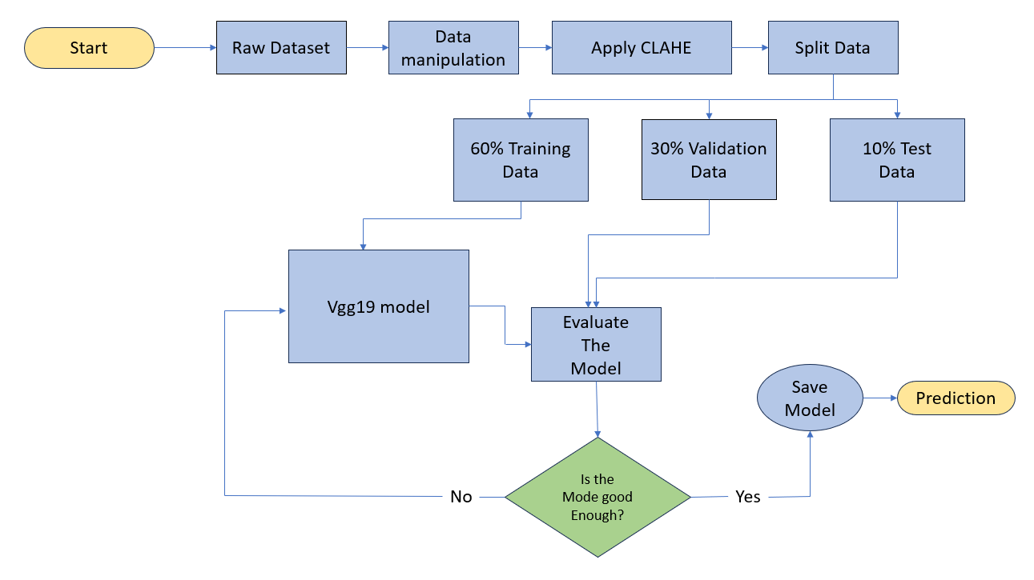
Project
Flowchart

Slide 8
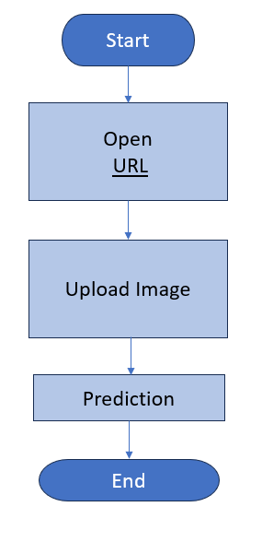

Slide 9

Screen Shoots

Slide 10


Slide 11


Slide 12
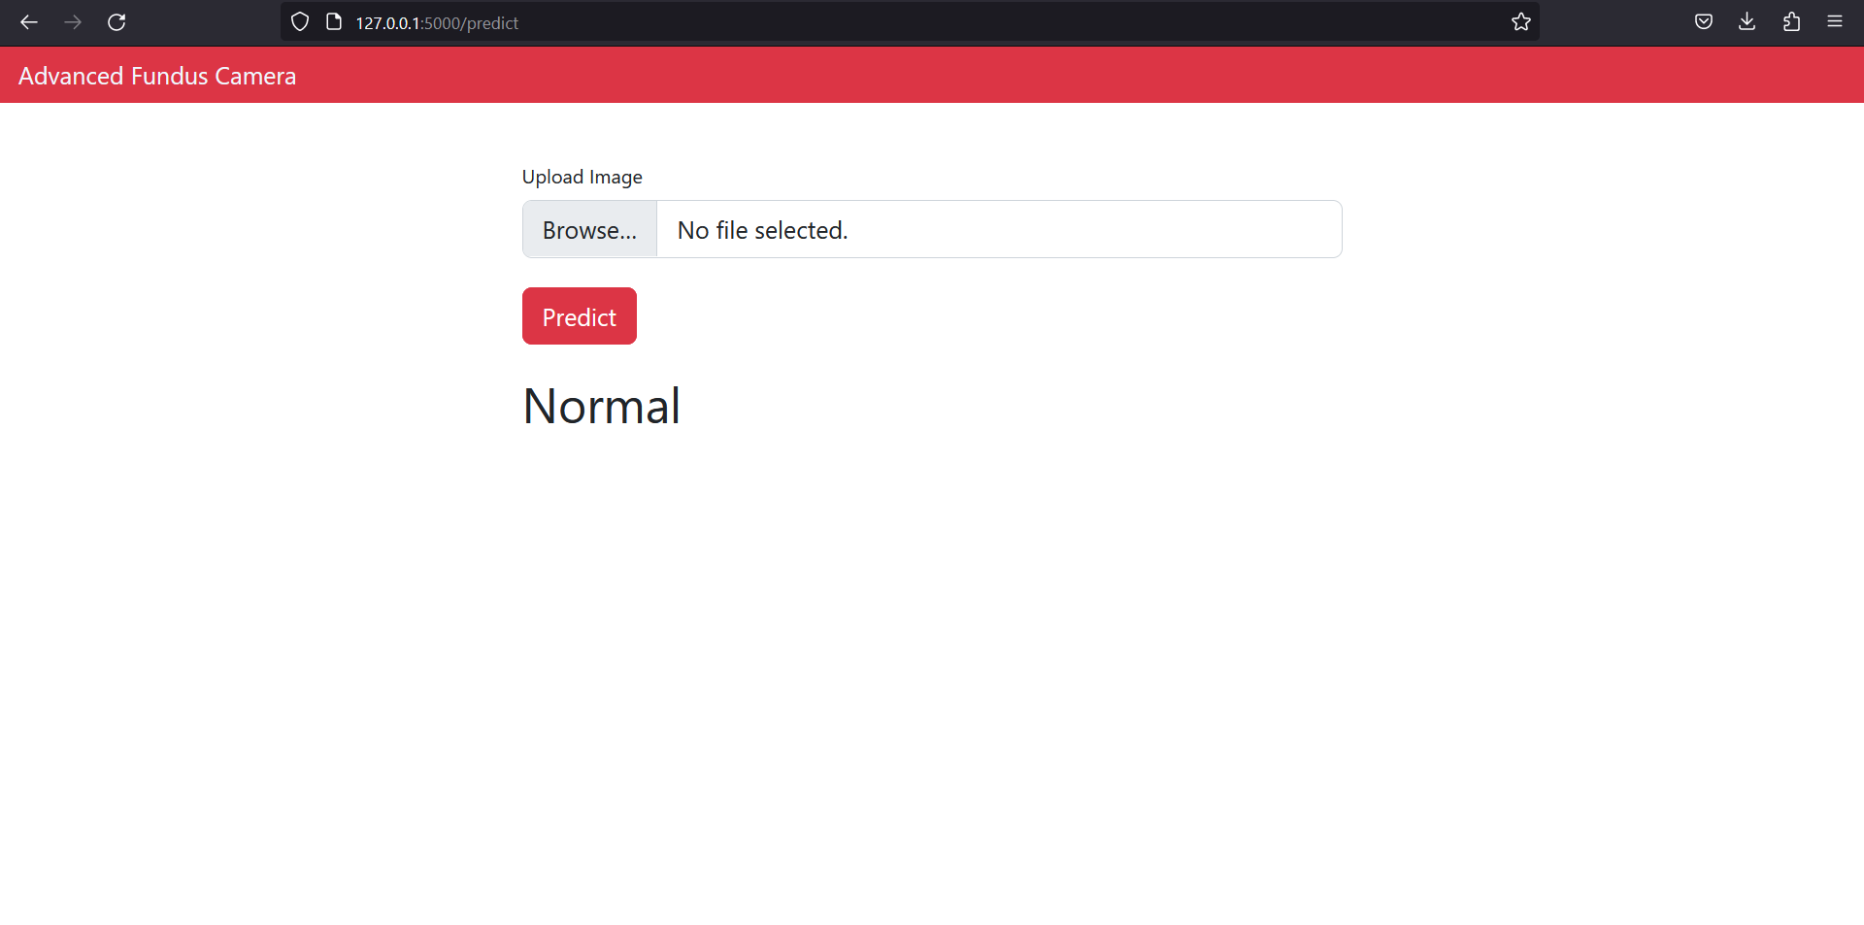

Slide 13
References
"Automated Diagnosis of Retinopathy of Prematurity Using Deep Convolutional Neural Networks“ - Daniel L. Rubin, Susan Y. Foosaner
"Deep Learning-Based Automated Detection of Diabetic Retinopathy Progression Using Ultra-Widefield Fundus Images“ - Shivang V. Dave, Prabu Mohan
"Fundus Photography Overview". www.opsweb.org. Ophthalmic Photographers' Society. Retrieved 2015-09-17.
Panwar, Nishtha; Huang, Philemon; Lee, Jiaying; Keane, Pearse A.; Chuan, Tjin Swee; Richhariya, Ashutosh; Teoh, Stephen; Lim, Tock Han; Agrawal, Rupesh (2015-08-26). "Fundus Photography in the 21st Century – A Review of Recent Technological Advances and Their Implications for Worldwide Healthcare". Telemedicine Journal and e-Health. 22 (3): 198–208. doi:10.1089/tmj.2015.0068. ISSN 1556-3669. PMC 4790203. PMID 26308281.

Slide 14
Thank you

